Slide 1




Design Specifications
IP AMBA ABP Protocol

Slide 2

Table Content
1
2
3
4
Specifications
High Level Block Design
Low Level Block Design
RTL Verification

Slide 3
1. Specifications

Slide 4
1. Specifications
1.1 Overview of the AMBA specification
The Advanced Microcontroller Bus Architecture (AMBA) specification defines an on-chip communications standard for designing high-performance embedded microcontrollers.
Four distinct buses are defined within the AMBA specification:
The Advanced High-performance Bus (AHB)
The Advanced System Bus (ASB)
The Advanced Peripheral Bus (APB).
The Advanced eXtensible Interface (AXI)

Slide 5
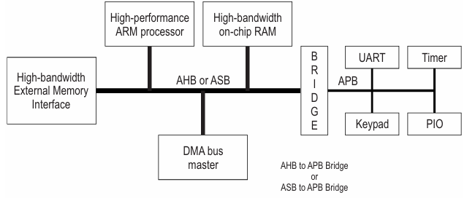
1. Specifications
1.1 Overview of the AMBA specification
AMBA AHB | AMBA ASB | AMBA APB
High performance | High performance | Low power
Pipelined operation | Pipelined operation | Latched address and control
Multiple bus masters | Multiple bus masters | Simple interface
Burst transfers |  | Suitable for many peripherals
Split transactions

Slide 6
1. Specifications
1.2 Key features of the AMBA Advanced Peripheral Bus (APB)
Low-cost interface: APB is designed with a simple architecture that minimizes hardware resources and implementation cost.
Low power consumption: The non-pipelined and simple transfer mechanism helps reduce power usage, making APB suitable for peripheral devices.
Synchronous protocol: All APB transactions are synchronized to the system clock.
Non-pipelined operation: Transfers are performed sequentially without overlapping phases.
Low bandwidth, optimized for control register access APB is intended for accessing programmable control registers rather than high-throughput data transfers.

Slide 7
1. Specifications
1.2 Key features of the AMBA Advanced Peripheral Bus (APB)
Designed for simple peripheral devices: Commonly used for peripherals such as GPIO, Timers, UART, SPI, and I2C.
Accessed through an APB bridge: APB peripherals are typically connected to the main system bus through a bridge (e.g., AXI-to-APB bridge).
Clear Requester–Completer model:
The APB bridge acts as the Requester, initiating transactions.
The peripheral device acts as the Completer, responding to requests.
Well-suited for AMBA-based multi-bus systems: APB integrates seamlessly with other AMBA buses such as AXI and AHB via bridges.

Slide 8
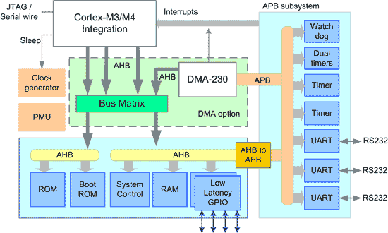
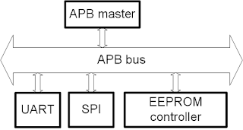
1. Specifications
1.2 Key features of the AMBA Advanced Peripheral Bus (APB)

Slide 9
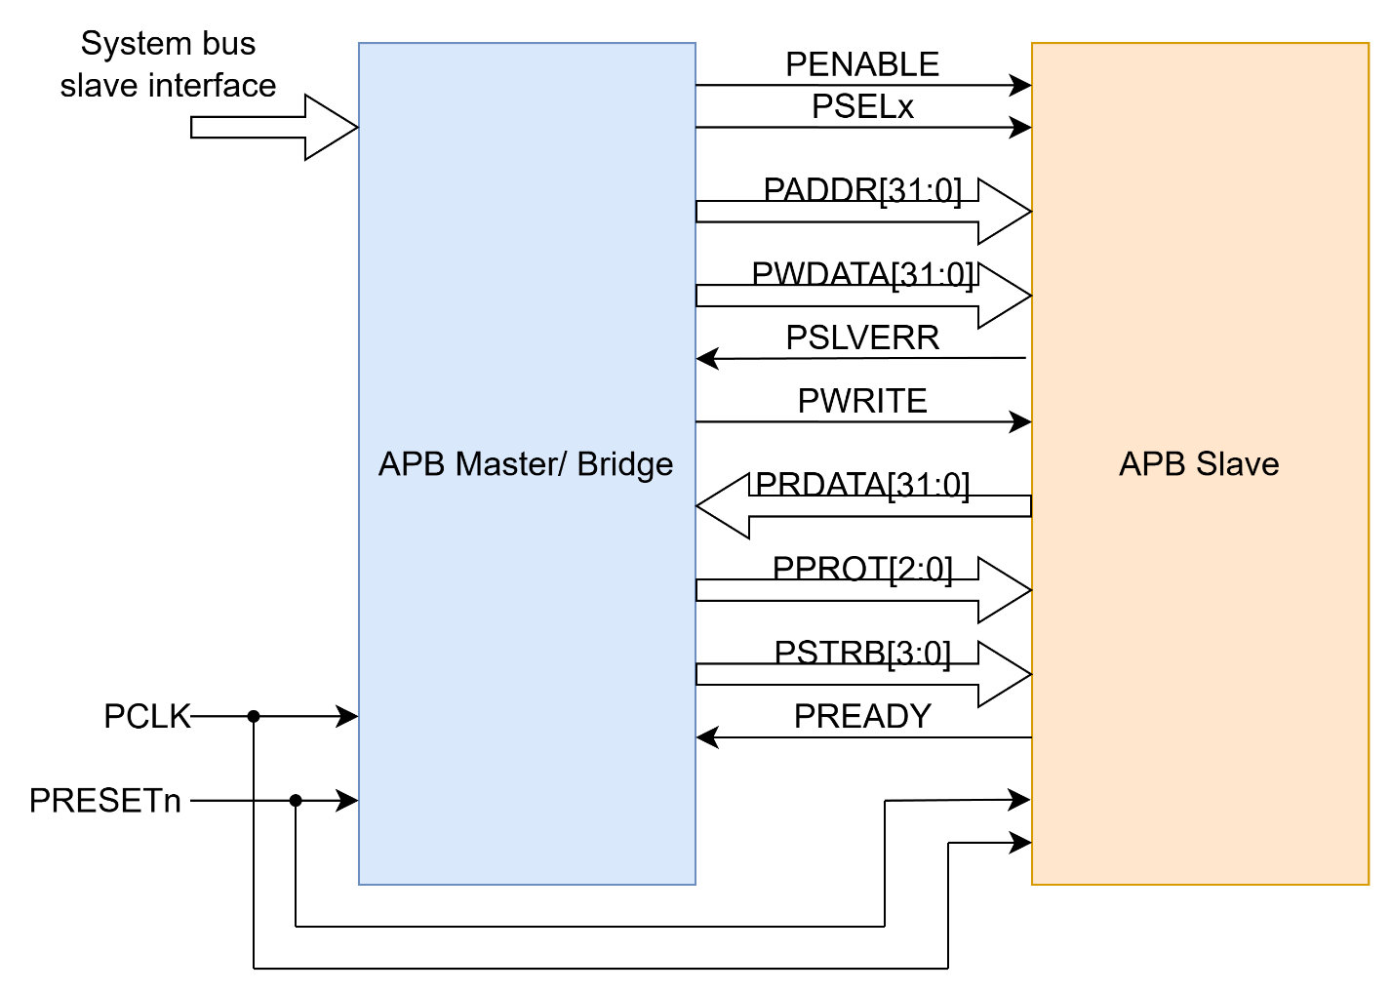
1. Specifications
1.3 AMBA ABP signals
Block Diagram & Signal Description of APB

Slide 10
1. Specifications
1.3 AMBA ABP signals
Signal | Source | Width | Description
PCLK | Clock Source | 1 | Clock. The rising edge of PCLK times all transfer on the APB
PRESETn | System Bus | 1 | Reset. The APB reset signal is active LOW. This signal is normally connected directly to the system bus reset signal.
PADDR | APB bridge | ADDR_WIDTH | Address. This is APB address bus. It can be up to 32 bits wide and is driven by the peripheral bus bridge unit.
PPROT | APB bridge | 3 | Protection type. This signal indicates the normal, privileged, or secure protection level of the transaction and whether the transaction is a data access or an instruction access.
PSELx | APB bridge | 1 | Slave select signal, there will be one PSEL signal for each slave connected to master.. It’s an active high signal.
PENABLE | APB bridge | 1 | Enable. It indicates the 2nd cycle of a data transfer. It’s an active high signal.

Slide 11
1. Specifications
1.3 AMBA ABP signals
Signal | Source | Width | Description
PWRITE | APB bridge | 1 | Direction. PWRITE indicates an APB write access when HIGH and an APB read access when LOW.
PWDATA | APB bridge | DATA_WIDTH | Write data. Write data bus from Master to Slave, can be up to 32 bit wide
PSTRB | APB bridge | DATA_WIDTH/8 | Write strobe. PSTRB indicates which byte lanes to update during a write transfer. There is one write strobe for each 8 bits of the write data bus. PSTRB[n] corresponds to PWDATA[(8n + 7):(8n)]. PSTRB must not be active during a read transfer.
PREADY | Slave Interface | 1 | It is used by the slave to include wait states in the transfer. i.e. whenever slave is not ready to complete the transaction, it will request the master for some time by de-asserting the PREADY.
PSLVERR | Slave Interface | 1 | Indicates the Success or failure of the transfer. HIGH indicates failure and LOW indicates Success
PRDATA | Slave Interface | DATA_WIDTH | Read data us from Slave to Master, can be up to 32 bit wide

Slide 12
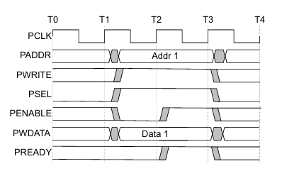
1. Specifications
1.3 APB Transfers – Write transfers
WRITE Transfer – Without Wait States
At T1, a write transfer with address PADDR,PWDATA,PWRITE and PSEL starts.
They will registered at the next rising edge of PCLK, T2.
This is Setup Phase of Transfer.
After T2, PENABLE and PREADY are registered at the rising edge of PCLK.
When asserted, PENABLE indicates starting of ACCESS Phase
When asserted, PREADY indicates that slave can complete the transfer at the next rising edige of PCLK.
PADDR, PDATA and control signals all should remain valid till the transfer completes at T3.
PENABLE signal will be de-asserted at the end of transfer.
PSEL is also de-asserted, if next transfer is not to the same slave.

Slide 13
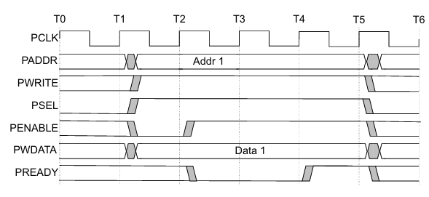
1. Specifications
1.3 APB Transfers – Write transfers
WRITE Transfer – With Wait States
During the ACCESS Phase, when PENABLE is high, the slave extends the transfer by driving PREADY low.
The PADDR, PWRITE, PSEL, PENABLE, PWDATA, PSTRB, PPROT signals should remain unchanged while PREADY is low
PREADY can take any value when PENABLE is low.
It is recommended that the address and write signals are not changed immediately after a transfer, but remain stable until another access occurs.

Slide 14
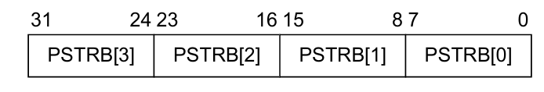
1. Specifications
1.3 APB Transfers – Write strobes
PSTRB enables sparse data transfer on the write data bus. Each PSTRB corresponds to 1 byte of the write data bus. When asserted HIGH, PSTRB indicates that the corresponding byte lane of the write data bus contains valid information.
There is one write strobe for each 8 bits of the write data bus, so PSTRB[n] corresponds to PWDATA[(8n + 7):(8n)].

Slide 15
1. Specifications
1.3 APB Transfers – Write strobes
PSTRB is an optional signal. An APB peripheral might support a limited set of access types, which must be documented for the programmer. This means that all combinations of PSTRB presence might be compatible, if this document states that sparse writes are not supported.
PSTRB | Completer: signal not present | Completer: signal present
Requester: signal not present | Compatible. Sparse writes are not supported. | Compatible. All write data byte lanes are valid for a write. Tie the PSTRB inputs to the PWRITE output from the Requester.
Requester: signal present | Compatible. Sparse writes are not supported. | Compatible.

Slide 16
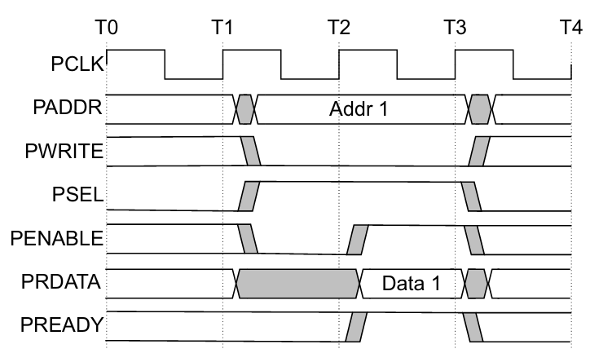
1. Specifications
1.3 APB Transfers – Read transfers
Read Transfer – Without Wait States
At T1, a READ transfer with address PADDR, PWRITE and PSEL starts.
They will be registered at rising edge of PCLK.
This is SETUP Phase of the transfer.
After T2, PENABLE and PREADY are registered at the rising edge of PCLK.
When asserted, PENABLE indicates the starting of ACCESS phase.
When asserted, PREADY indicates that slave can complete the transfer at next rising edge of PCLK by providing the data on PRDATA.
Slave must provide the data before the end of read transfer. i.e. before T3.

Slide 17
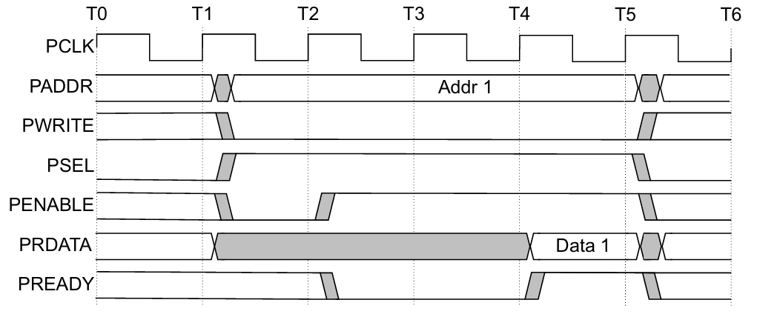
1. Specifications
1.3 APB Transfers – Read transfers
Read Transfer – With Wait States
During the ACCESS Phase, when PENABLE is high, the slave extends the transfer by driving PREADY low.
The PADDR, PWRITE, PSEL, PENABLE, PPROT signals should remain unchanged while PREADY is low

Slide 18
1. Specifications
1.3 APB Transfers – Error response
Whenever there is a problem in the transfer, Slave indicates the error response for the transfer by asserting the PSLVERR signal. PSLVERR is only considered valid during the last cycle f and APB transfer, when PSEL, PENABLE and PREADY are all HIGH. It is recommended, but not mandatory that you drive PSLVERR low when it is not being sampled.
Transactions that receive an error response, might or might not have changed the state of peripheral. For example, If APB master performs a write transaction to an APB slave and received an error response, it is not guaranteed that the data is not written on the slave peripheral.

Slide 19
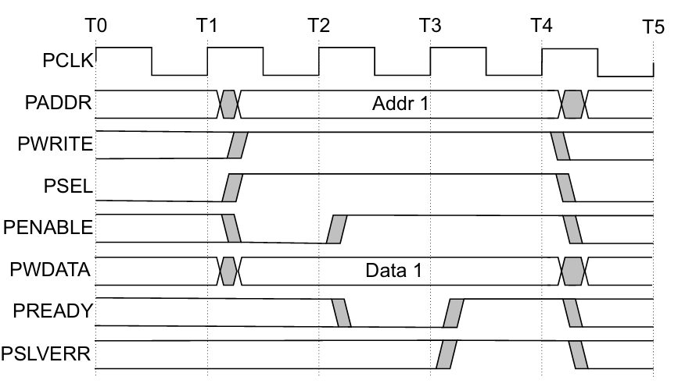
1. Specifications
1.3 APB Transfers – Error response
Write transfers

Slide 20
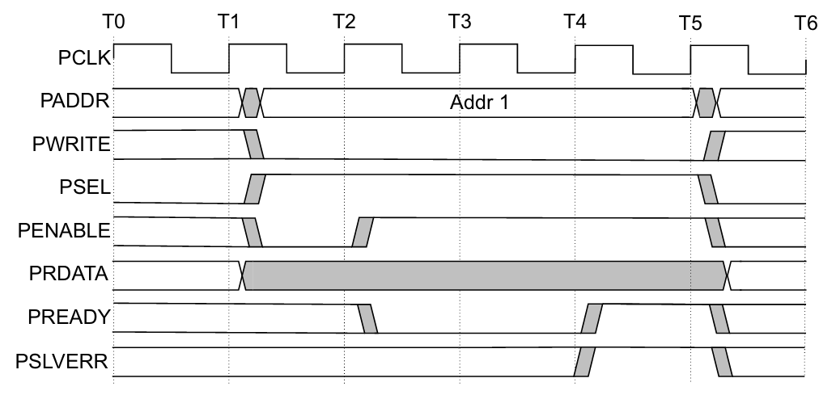
1. Specifications
1.3 APB Transfers – Error response
Read transfers

Slide 21
1. Specifications
1.3 APB Transfers – Protection until support
To support complex system designs, it is often necessary for both the interconnect and other devices in the system to provide protection against illegal transactions. It is provided by Protection Unit in APB Protocol. The signals indicating the protection unit are PPROT[2:0].
PPROT | Protection | Description | Comments
PPROT[0] | Normal or Privileged | PPROT[0] is used by Requesters to indicate processing mode. A privileged processing mode typically has a greater level of access within a system. | LOW indicates normal access. HIGH indicates privileged access.
PPROT[1] | Secure or Non-secure | PPROT[1] is used in systems where a greater degree of differentiation between processing modes is required. | LOW indicates secure access. HIGH indicates non-secure access
PPROT[2] | Data or Instruction | PPROT[2] gives an indication if the transaction is a data or instruction access. The transaction indication is provided as a hint and might not be accurate in all cases. | LOW indicates data access. HIGH indicates instruction access.

Slide 22
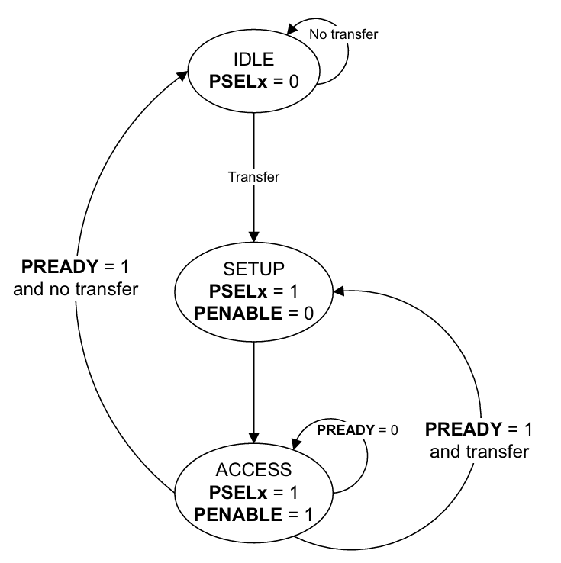
1. Specifications
1.4 Operation States
IDLE | This is the default state of the APB interface.
SETUP | When a transfer is required, the interface moves into the SETUP state, where the appropriate select signal, PSELx, is asserted. The interface only remains in the SETUP state for one clock cycle and always moves to the ACCESS state on the next rising edge of the clock.

Slide 23
1. Specifications
1.4 Operation States
ACCESS | PENABLE is asserted in the ACCESS state. During the transition from SETUP to ACCESS and throughout the ACCESS state, the following signals must remain stable: PADDR, PPROT, PWRITE, PSTRB, PAUSER, PWUSER, and PWDATA (for write transfers only). The exit from the ACCESS state depends on PREADY from the Completer: if PREADY is LOW, the bus stays in ACCESS; if PREADY is HIGH, the bus leaves ACCESS and returns to IDLE or moves directly to SETUP for the next transfer.

Slide 24
2. High Level Block Design

Slide 25
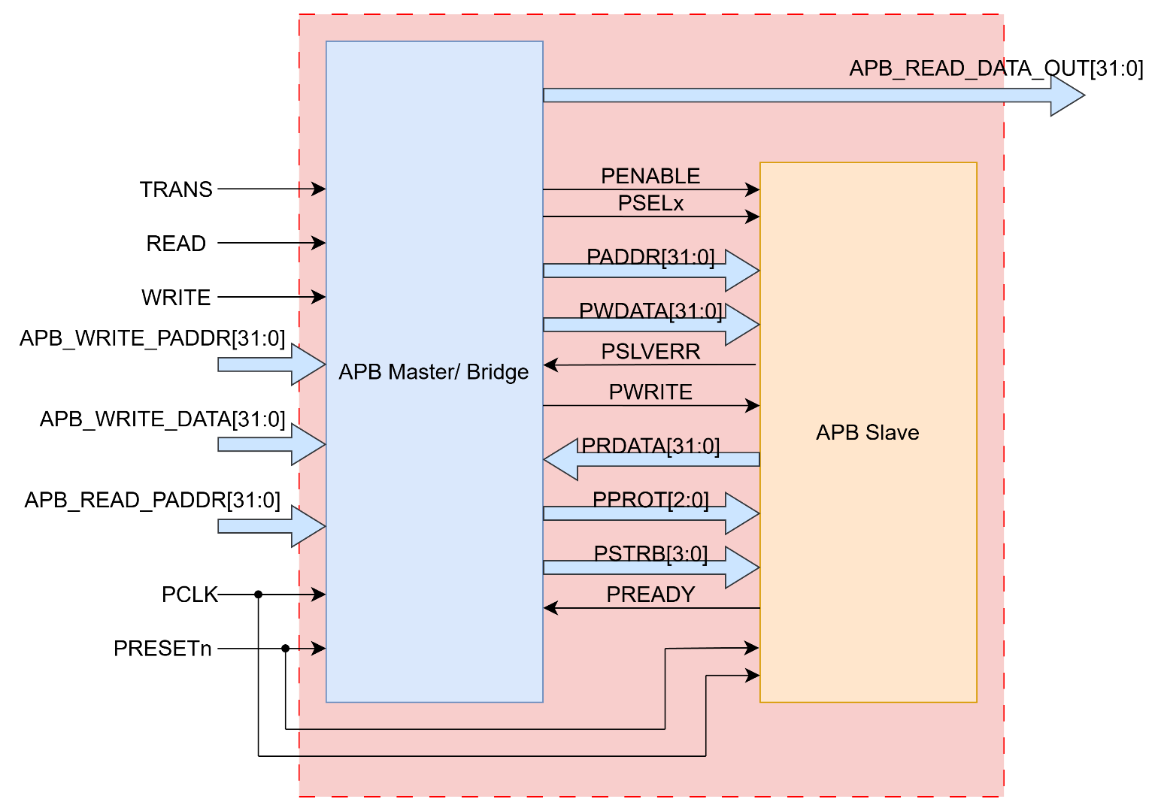
2. High Level Block Design
2.1 APB Interface
APB Interface

Slide 26
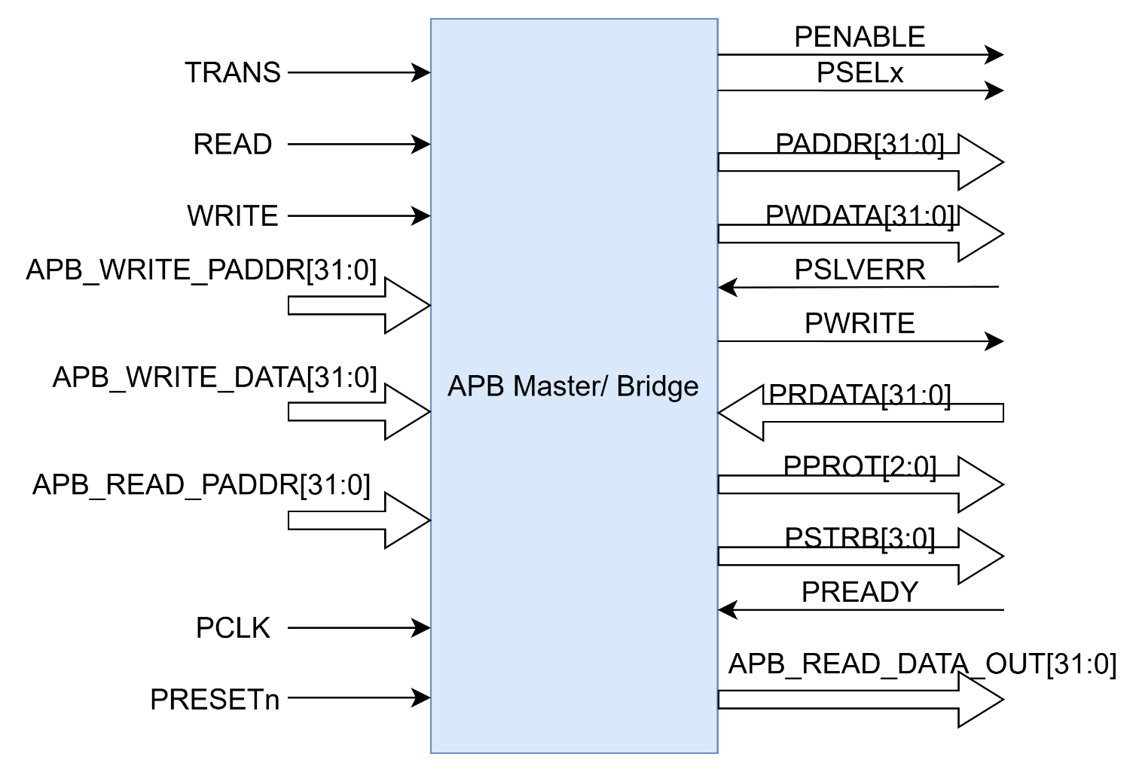
2. High Level Block Design
2.2 APB Master
APB Master block

Slide 27
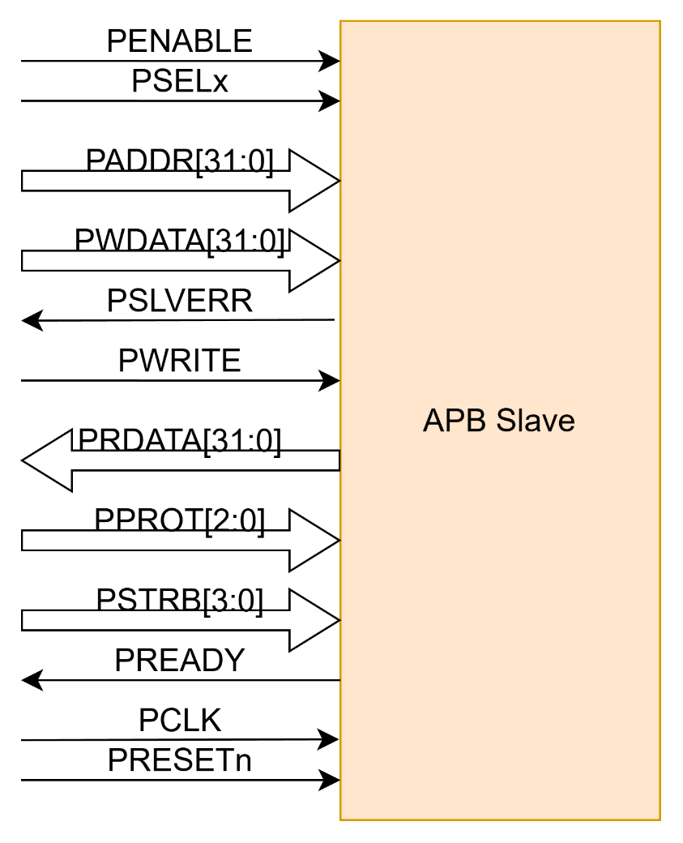
2. High Level Block Design
2.3 APB Slave
APB Slave block

Slide 28
2. High Level Block Design
2.4 AMBA ABP Interface signals
Signal | Source | Width | Description
TRANS | System BUS | 1 | Start signal. When the TRANS signal is set to HIGH, the system will begin operation. This signal may remain active for one clock cycle or multiple cycles.
READ | System BUS | 1 | Read signal.
WRITE | System BUS | 1 | Write signal.
APB_WRITE_PADDR | System BUS | ADDR_WIDTH | Address. This is the APB write address used by the APB master to write data to the slave. The address can be up to 32 bits wide.
APB_WRITE_DATA | System BUS | DATA_WIDTH | Data Write. This is the data sent from the APB master to the APB slave during a write operation. The data width can be up to 32 bits.
APB_READ_PADDR | System BUS | ADDR_WIDTH | Address. This is the APB read address used by the APB master to read data from the slave. The address can be up to 32 bits wide.
APB_READ_DATA_OUT | System BUS | DATA_WIDTH | Data Out. This is the data which is read from slave. The data width can be up to 32 bits.

Slide 29
2. High Level Block Design
2.4 AMBA ABP Interface signals
Signal | Source | Width | Description
PCLK | Clock Source | 1 | Clock. The rising edge of PCLK times all transfer on the APB
PRESETn | System Bus | 1 | Reset. The APB reset signal is active LOW. This signal is normally connected directly to the system bus reset signal.
PADDR | APB bridge | ADDR_WIDTH | Address. This is APB address bus. It can be up to 32 bits wide and is driven by the peripheral bus bridge unit.
PPROT | APB bridge | 3 | Protection type. This signal indicates the normal, privileged, or secure protection level of the transaction and whether the transaction is a data access or an instruction access.
PSELx | APB bridge | 1 | Slave select signal, there will be one PSEL signal for each slave connected to master.. It’s an active high signal.
PENABLE | APB bridge | 1 | Enable. It indicates the 2nd cycle of a data transfer. It’s an active high signal.

Slide 30
2. High Level Block Design
2.4 AMBA ABP Interface signals
Signal | Source | Width | Description
PWRITE | APB bridge | 1 | Direction. PWRITE indicates an APB write access when HIGH and an APB read access when LOW.
PWDATA | APB bridge | DATA_WIDTH | Write data. Write data bus from Master to Slave, can be up to 32 bit wide
PSTRB | APB bridge | DATA_WIDTH/8 | Write strobe. PSTRB indicates which byte lanes to update during a write transfer. There is one write strobe for each 8 bits of the write data bus. PSTRB[n] corresponds to PWDATA[(8n + 7):(8n)]. PSTRB must not be active during a read transfer.
PREADY | Slave Interface | 1 | It is used by the slave to include wait states in the transfer. i.e. whenever slave is not ready to complete the transaction, it will request the master for some time by de-asserting the PREADY.
PSLVERR | Slave Interface | 1 | Indicates the Success or failure of the transfer. HIGH indicates failure and LOW indicates Success
PRDATA | Slave Interface | DATA_WIDTH | Read data us from Slave to Master, can be up to 32 bit wide

Slide 31
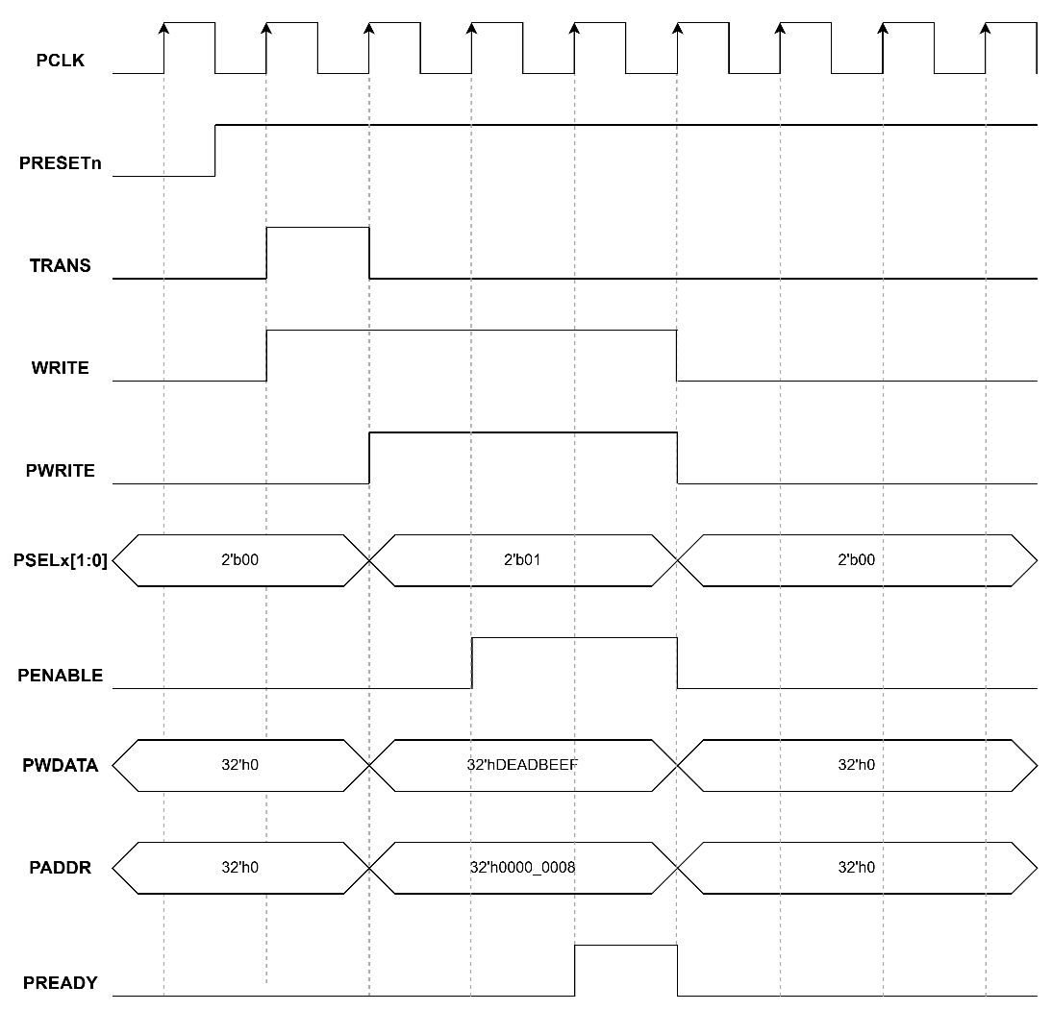

2. High Level Block Design
2.4 AMBA ABP Interface signals
APB Write transfer without waiting state
APB Read transfer without waiting state

Slide 32


2. High Level Block Design
2.4 AMBA ABP Interface signals
APB Write with Slave 1 access
APB Read with Slave 1 access

Slide 33


2. High Level Block Design
2.4 AMBA ABP Interface signals
APB Write transfer with waiting state
APB Read transfer with waiting state

Slide 34
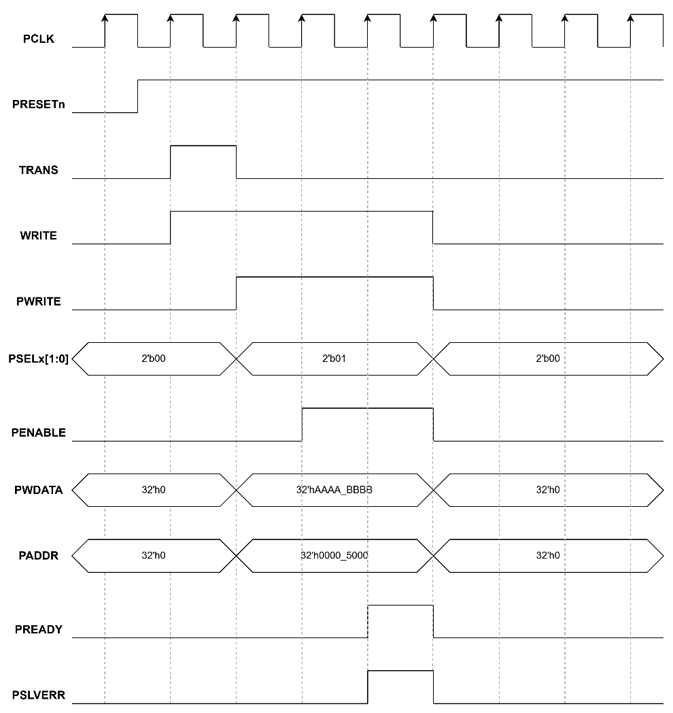
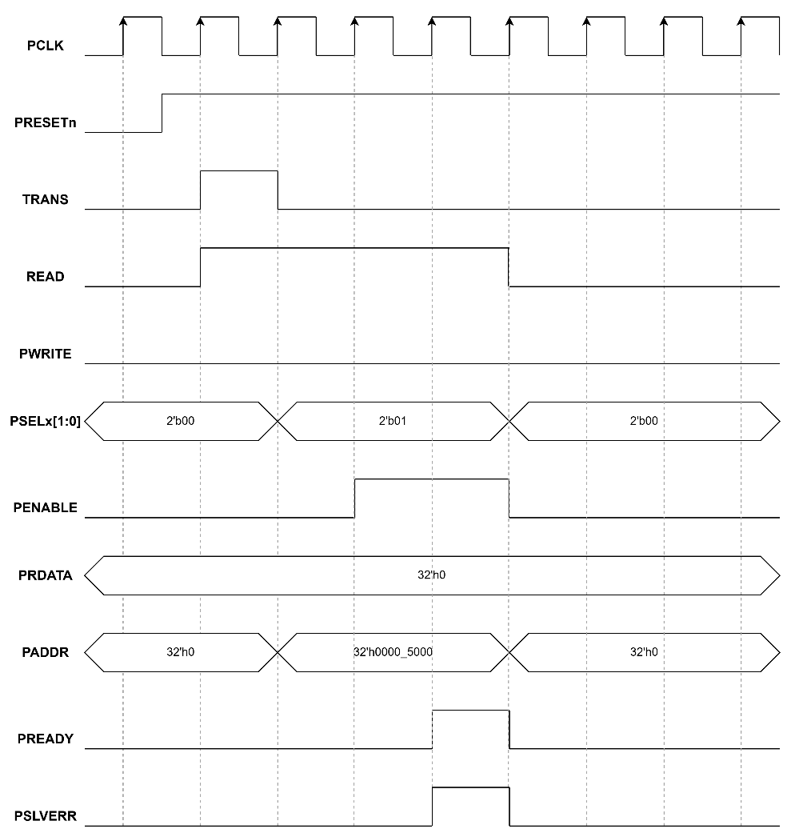
2. High Level Block Design
2.4 AMBA ABP Interface signals
APB Write with address range error
APB Read with address range error

Slide 35
3. Low Level Block Design

Slide 36
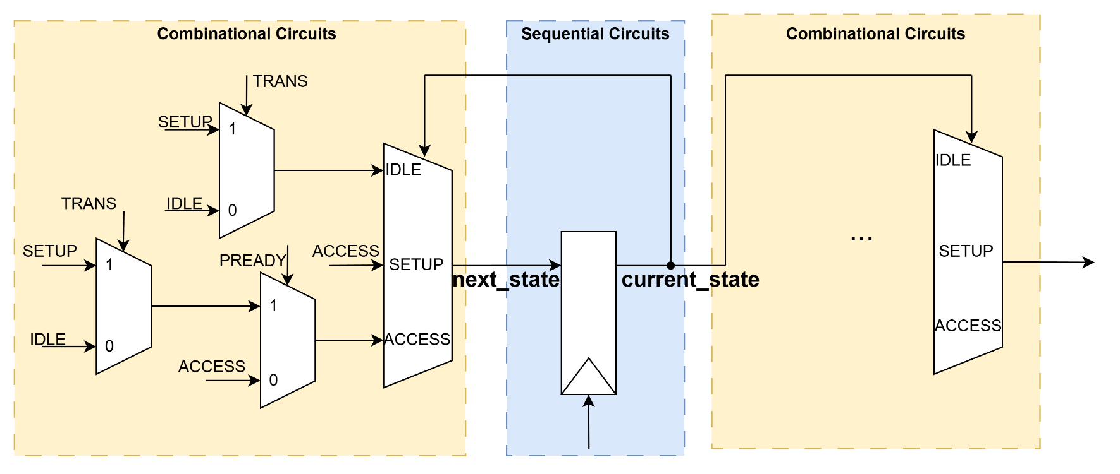
3. Low Level Block Design
3.1 APB Master block
APB FSM block

Slide 37
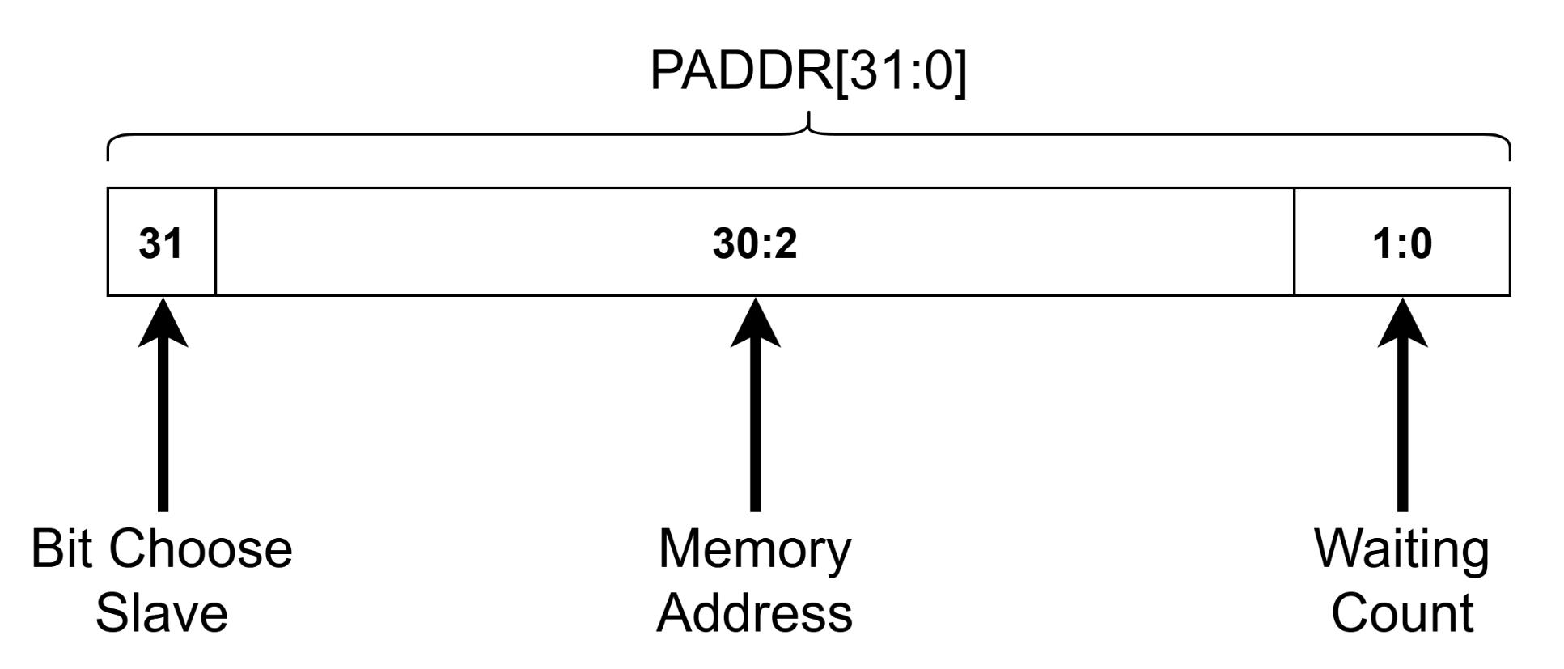
3. Low Level Block Design
3.2 APB Slave block
APB PADDR Config

Slide 38

3. Low Level Block Design
3.2 APB Slave block
BUS Signals | Name | Descriptions
PADDR[31] | Slave Select Bit | Used to select the target slave. 0 selects Slave 0; 1 selects Slave 1.
PADDR[30:2] | Memory Address | These bits represent the internal memory index (Word-aligned). They are used to access specific data entries within the slave's memory array.
PADDR[1:0] | Waiting Count | These bits determine the number of wait states (delay cycles) the Slave will force the Master to wait before completing the transaction.

Slide 39
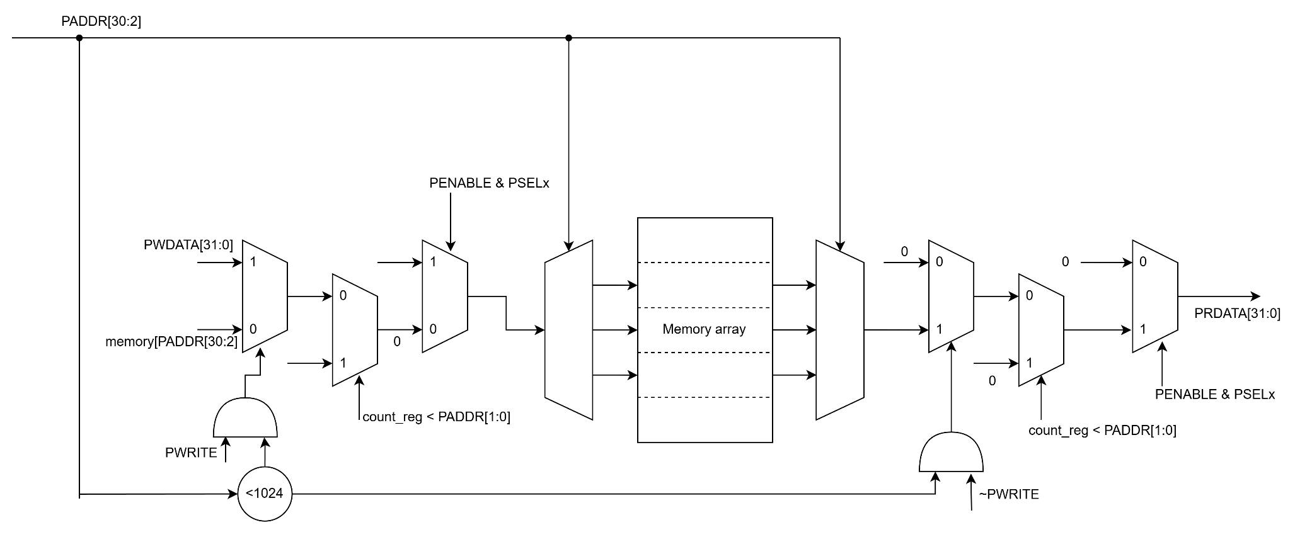
3. Low Level Block Design
3.2 APB Slave block
APB Slave RAM

Slide 40

3. Low Level Block Design
3.2 APB Slave block
APB Output signals

Slide 41
4. RTL Verification

Slide 42
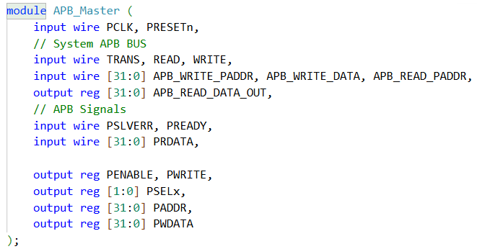
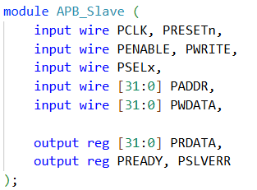
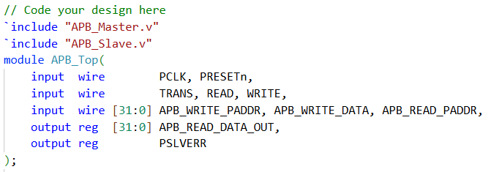
4. RTL Verification
4.1 RTL Design
APB Master
APB Slave
APB Top

Slide 43
4. RTL Verification
4.2 Verification Plans
Test case | Descriptions | Expected results
Write/Read Slave 0 | Perform a write of 0xDEADBEEF to address 0x8 (Slave 0, Wait = 0) of Slave 0, followed by a read from the same address. | PSELx[0] must be asserted (logic 1).
 |  | Read data must match the written value (0xDEADBEEF).
 |  | PSLVERR must be 0.
Write/Read Slave 1 | Perform a write of 0xCAFEBABE to address 0x8000_0004 (Slave 1, Wait = 0), followed by a read from the same address. | PSELx[1] must be asserted.
 |  | Read data must match the written value (0xCAFEBABE).
 |  | PSLVERR must be 0.
Address Range Error | Access (Read/Write) address 0x00005000 (PADDR[30:2] is 1400 in Decimal), which exceeds the memory size (1024) of the Slave. | Slave must still respond with PREADY = 1.
 |  | PSLVERR signal must be asserted (logic 1) during both Write and Read cycles.
 |  | Read data should return 0.

Slide 44
4. RTL Verification
4.2 Verification Plans
Test case | Descriptions | Expected results
Write/Read with Dynamic Wait States | Perform Write and Read transactions using addresses with specific last two bits (PADDR[1:0], e.g., ...03 and ...01) to trigger the Slave's delayed response mechanism. | Master must maintain the ACCESS state (PENABLE=1) and keep address/data stable throughout the wait cycles.
 |  | For an address ending in ...03, the Slave must hold PREADY low for exactly 3 clock cycles before completion.
 |  | The simulation log must display [WAITING] messages corresponding to the actual number of wait cycles injected.

Slide 45
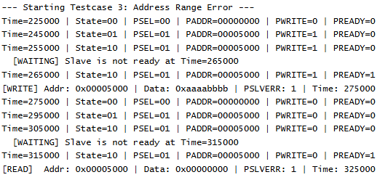
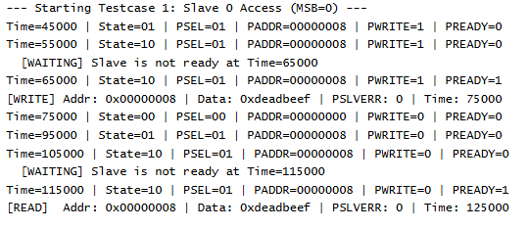
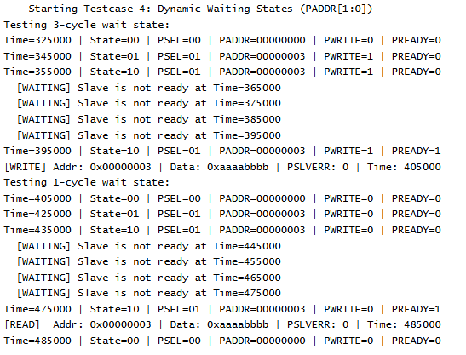
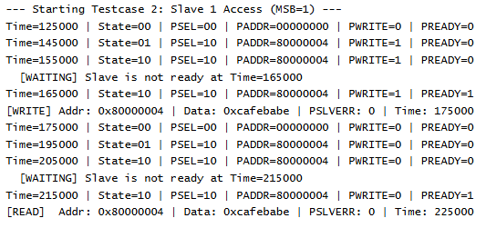
4. RTL Verification
4.3 Results

Slide 46
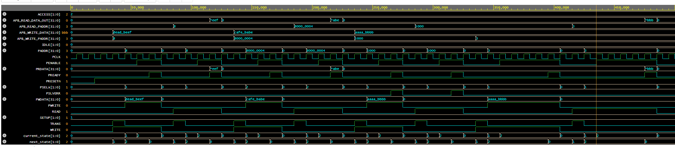
4. RTL Verification
4.3 Results

Slide 47




Thanks for watching

